Slide 1
Algorithms & data vs performance & accuracy
How to decide on data and algorithms based on performance afforded and accuracy expected
Anton Georgescu
Principal Product Architect, TEMS
Loan-Star Team, Standish, Canada

Slide 2
Agenda
A few more classification algorithms…
Logistic regression (demo)
Naïve Bayes (demo)
Decision Trees (demo)
Random Forest (demo)
Algorithm performance
Performance applied to estimation measures (demo)
Processing time & accuracy: compare algorithms
Cross-validation to tune the model
Estimate algorithm accuracy through cross-validation
Processing time & accuracy: prepare your data
Dimensions vs Performance
Dimensions vs Confusion Matrix
Choosing the right algorithm for the right dataset

Slide 3
A few more classification algorithms…
Logistic Regression
Also called LOGIT: is the most commonly used classification procedure. It’s used in credit scoring, in life sciences, medicine, social sciences, economics, business, image classification etc
Decision Tree
I found concrete references on internet about actual applications in predicting high occupancy dates for hotels; identifying factors leading to better gross margins on a retail chain; classification systems for serial criminal patterns (CSSCP); screening potential terrorists and drug smugglers at border crossings
Random Forest
Example on web on city urban planning, credit card default predictions etc.
Naïve Bayes
Categorizing news, email spam detection, face recognition, sentiment analysis, medical diagnosis, digit recognition and weather prediction are just few of the popular use cases of Naive Bayes algorithm

Slide 4
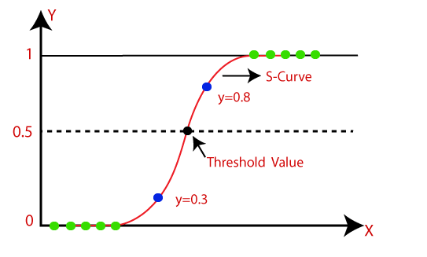
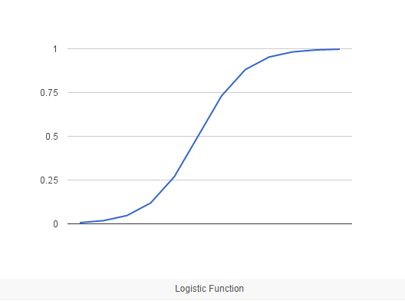
Logistic Regression
Classification algorithm, that is used where the response variable is categorical. The idea of Logistic Regression is to find a relationship between features and probability of particular outcome.
It is a special case of linear regression where the target variable is categorical in nature
This problem is referred in math as Binomial Logistic Regression, where the response variable has two values 0 and 1 or pass and fail or true and false.
Multinomial Logistic Regression deals with situations where the response variable can have three or more possible values.
Logistic regression is named for the function used at the core of the method, the logistic function (also called “sigmoid function”)
sigmoid function was developed by statisticians to describe properties of population growth in ecology
In Logistic regression, instead of fitting a regression line, we fit an "S" shaped logistic function, which predicts two maximum values (0 or 1).
the curve from the logistic function indicates the likelihood of an outcome
Demo: https://github.com/antongeorgescu/machine-learning-documentation/blob/master/scripts/WineQualityAnalysis_LogisticRegression_Correlation.ipynb

Slide 5
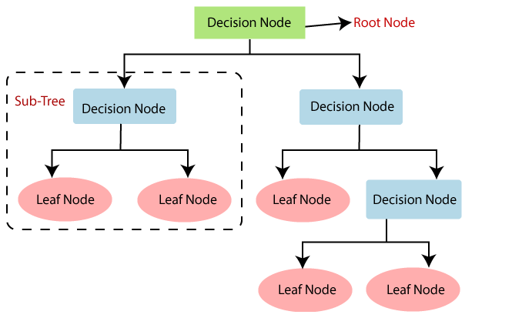
Decision Tree
It is a tree-structured classifier, where internal nodes represent the features of a dataset, branches represent the decision rules and each leaf node represents the outcome.
In a Decision tree, there are two nodes, which are the Decision Node and Leaf Node. Decision nodes are used to make any decision and have multiple branches, whereas Leaf nodes are the output of those decisions and do not contain any further branches.
The decisions or the test are performed on the basis of features of the given dataset.
It is called a decision tree because, similar to a tree, it starts with the root node, which expands on further branches and constructs a tree-like structure.
In order to build a tree, we use the CART algorithm, which stands for Classification and Regression Tree algorithm.
A decision tree simply asks a question, and based on the answer (Yes/No), it further split the tree into subtrees.
Demo: https://github.com/antongeorgescu/machine-learning-documentation/blob/master/scripts/WineQualityAnalysis_DecisionTree_Correlation.ipynb

Slide 6
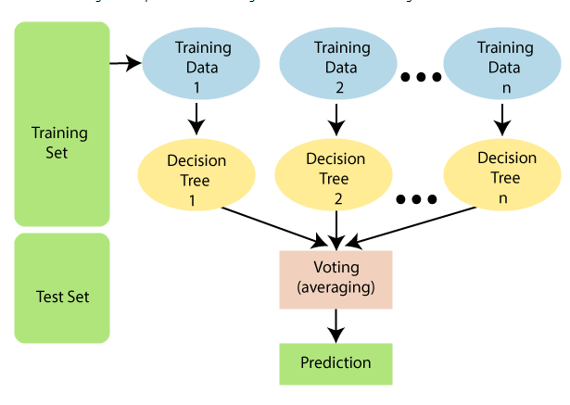
Random Forest
Random Forest is a popular machine learning algorithm that belongs to the supervised learning technique. It can be used for both Classification and Regression problems in ML.
It is based on the concept of ensemble learning, which is a process of combining multiple classifiers to solve a complex problem and to improve the performance of the model.
Random Forest is a classifier that contains a number of decision trees on various subsets of the given dataset and takes the average to improve the predictive accuracy of that dataset.
Instead of relying on one decision tree, the random forest takes the prediction from each tree and based on the majority votes of predictions, and it predicts the final output.
The greater number of trees in the forest leads to higher accuracy and prevents the problem of overfitting.
Why use Random Forest?
It takes less training time as compared to other algorithms.
It predicts output with high accuracy, even for the large dataset it runs efficiently.
It can also maintain accuracy when a large proportion of data is missing.
Demo: https://github.com/antongeorgescu/machine-learning-documentation/blob/master/scripts/WineQualityAnalysis_RandomForest_Correlation.ipynb

Slide 7
Naïve Bayes
is based on Bayes theorem and used for solving classification problems.
It is mainly used in text classification that includes a high-dimensional training dataset.
Naïve Bayes Classifier is one of the simple and most effective Classification algorithms which helps in building the fast machine learning models that can make quick predictions.
it is a probabilistic classifier, which means it predicts on the basis of the probability of an object.
some popular examples of Naïve Bayes Algorithm are spam filtration, Sentimental analysis, and classifying articles.
It is called Naïve because it assumes that the occurrence of a certain feature is independent of the occurrence of other feature
3 types of Naïve Bayes algorithm
Gaussian: assumes that features follow a normal distribution.
This means if predictors take continuous values instead of discrete, then the model assumes that these values are sampled from the Gaussian distribution.
Multinomial: is used when the data is multinomial distributed.
It is primarily used for document classification problems, it means a particular document belongs to which category such as Sports, Politics, education, etc.
Bernoulli: works similar to the Multinomial classifier, but the predictor variables are the independent Booleans variables.
Such as if a particular word is present or not in a document. This model is also famous for document classification tasks.
Demo: https://github.com/antongeorgescu/machine-learning-documentation/blob/master/scripts/WineQualityAnalysis_NaiveBayes_Correlation.ipynb

Slide 8
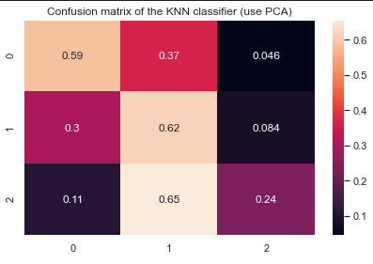
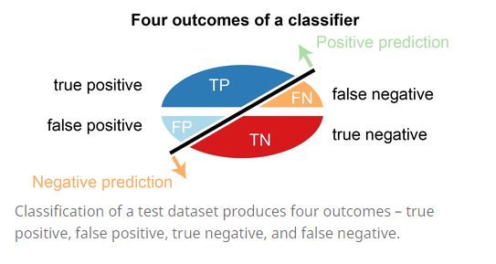
Algorithm performance & Confusion Matrix
Four popular measures of prediction (a.k.a test from train/test pattern) accuracy:
Accuracy
Precision
Recall
F1-Score
All come from calculations made “confusion matrix” which is a table that contains outcomes produced by a classification algorithm
By definition the confusion matrix is is a two by two table that contains four outcomes produced by a binary classifier
The image beside shows the four possible outcomes of a binary classifier
The confusion matrix has been generalized for multicategory classifiers (like we have in our Wine Dataset analysis)
In the table above 0,1,2 correspond to 3 qualities of wine (eg. 5,6,7)
Value in col:2/row:2 corresponds to % of correctly predicted quality 6 as 6 (i.e. 62%)
Value in col:1/row:2 corresponds to % of incorrectly predicted quality 6 as 5 (i.e. 30%)
Value in col:3/row:3 corresponds to % of incorrectly predicted quality 6 as 7 (i.e. 8.4%)

Slide 9
Prediction performance measures
Error Rate
the number of all incorrect predictions divided by the total number of the dataset. The best error rate is 0.0, whereas the worst is 1.0
Accuracy
the number of all correct predictions divided by the total number of the dataset. The best accuracy is 1.0, whereas the worst is 0.0. It can also be calculated by 1 – ERR.
Precision
the number of correct positive predictions divided by the total number of positive predictions. It is also called positive predictive value (PPV). The best precision is 1.0, whereas the worst is 0.0.
Recall
the number of correct positive predictions divided by the total number of positives. It is also called sensitivity (SN) or true positive rate (TPR). The best sensitivity is 1.0, whereas the worst is 0.0.
F1-Score
F-score is a harmonic mean of precision and recall.
Demo: run Python script under https://github.com/antongeorgescu/machine-learning-documentation/blob/master/scripts/GetAggregatedSummary_Algorithms_All.ipynb

Slide 10
Processing time & accuracy: compare algorithms
Wine Quality Analysis – Algorithm Comparison
k-Nearest Neighbour (KNN)
Processing (sec):0.1141 Accuracy: 56.50% F1-Score: 0.5650
Logistic Regression
Processing (sec):0.0430 Accuracy: 55.14% F1-Score: 0.5514
Support Vector Machine (SVM)
Processing (sec): 42.52 Accuracy: 57.10% F1-Score: 0.5414
Note: Parameters fit:41.7699; Predictions:0.7615
Naive Bayes
Processing (sec):0.0040 Accuracy: 0.4960 F1-Score: 0.4960
Decision Tree
Processing (sec):0.0220 Accuracy: 0.5410 F1-Score: 0.5410
Random Forest
Processing (sec):0.4364 Accuracy: 0.5618 F1-Score: 0.5618

Slide 11
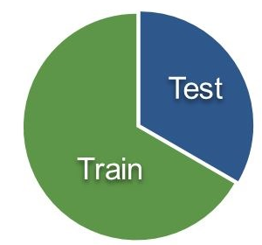
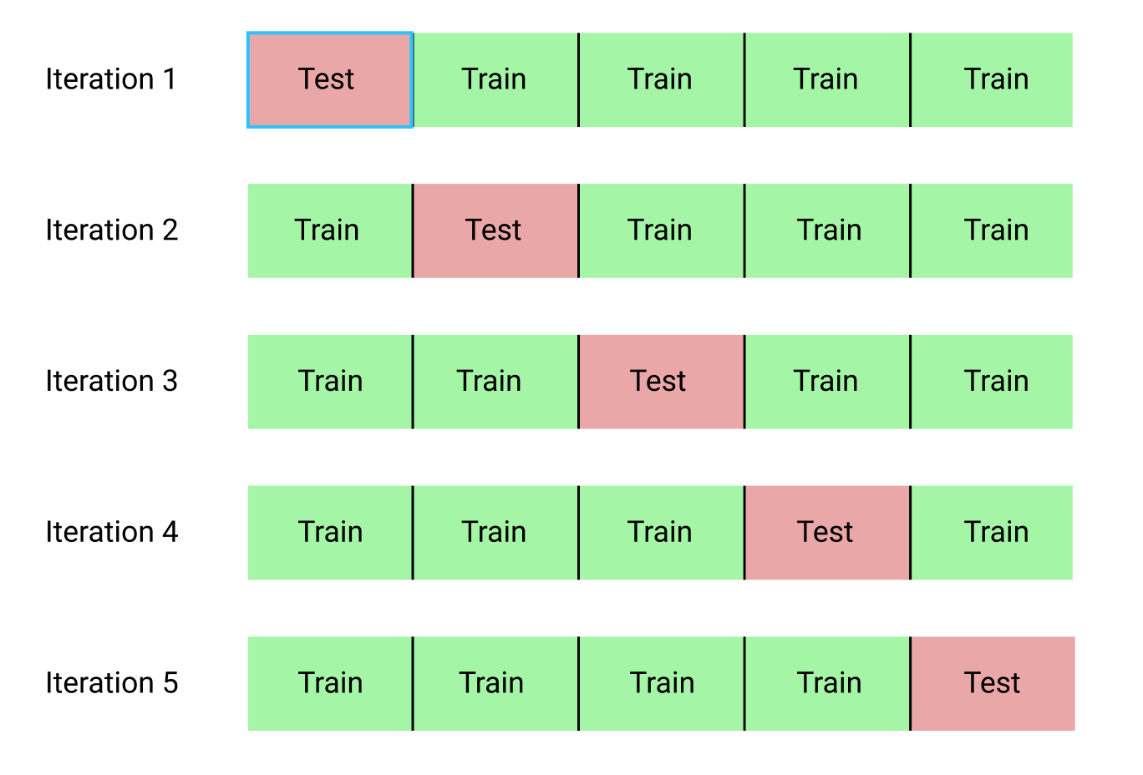
Cross-validation to tune the model
To evaluate the performance of any ML model we need to test it on some unseen data.
based on the models performance on unseen data we can say weather our model is Under-fitting/Over-fitting/Well-generalised.
Cross validation (CV) is one of the technique used to test the effectiveness of a model
it is also a re-sampling procedure used to evaluate a model if we have a limited data.
need to keep aside a sample/portion of the data on which is do not use to train the model, later us this sample for testing/validating
Common methods used for CV:
Train/Test Split
randomly split the complete data into training and test sets, then Perform the model training on the training set and use the test set for validation purpose, ideally split the data into 70:30 or 80:20
K-Folds Cross Validation
has a single parameter called k that refers to the number of groups that a given data sample is to be split into
Other CV: Stratified K-fold, Leave One Out
Train/test split CV
K-Fold CV
Demo: https://github.com/antongeorgescu/machine-learning-documentation/blob/master/scripts/WineQualityAnalysis_NaiveBayes_Correlation.ipynb

Slide 12
Estimate algorithm accuracy through cross-validation
estimate the accuracy of the 6 classifiers we use on the wine dataset by splitting the data, fitting each model and computing the score 5 consecutive times (with different splits each time)
calculate the accuracy average over 5 iterations, for each classifier
results for NO-SPLITS = 5
KNN Classifier
[0.38728324 0.45417011 0.552436 0.53719008 0.5214876 ] Accuracy: 0.49 (+/- 0.12)
SVM Classifier
[0.47563997 0.47811726 0.56647399 0.5768595 0.5661157 ] Accuracy: 0.53 (+/- 0.09)
Logistic Regression Classifier
[0.46490504 0.48472337 0.57060281 0.59008264 0.55867769] Accuracy: 0.53 (+/- 0.10)
Random Forest Classifier
[0.45334434 0.50289017 0.5821635 0.57768595 0.56198347] Accuracy: 0.54 (+/- 0.10)
Decision Tree Classifier
[0.45995045 0.48142031 0.50619323 0.53966942 0.52231405] Accuracy: 0.50 (+/- 0.06)
Naïve Bayes Classifier
[0.36746491 0.50949628 0.46738233 0.45867769 0.37933884] Accuracy: 0.44 (+/- 0.11)

Slide 13
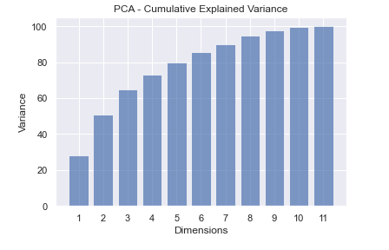
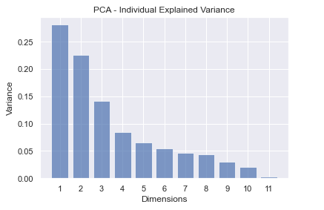
Processing time & accuracy: prepare your data
Break the course of dimensionality: reduce
Apply PCA algorithms
Identify the number of dimensions that provide the highest reduction with preservation of a decent variance

Slide 14
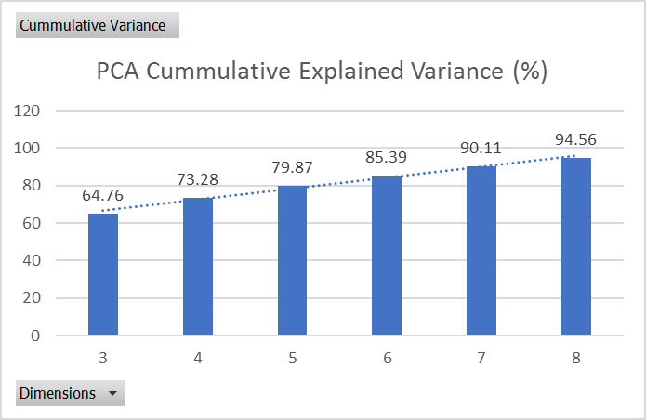
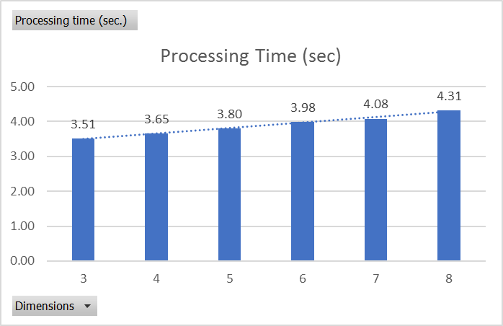
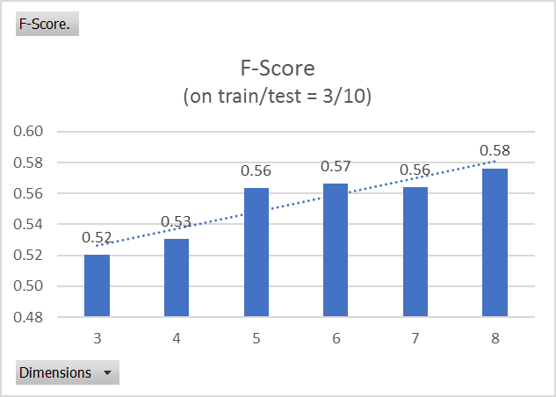
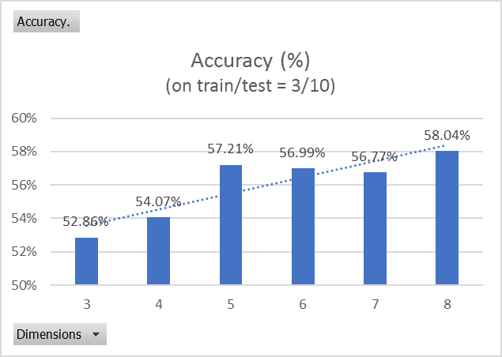
Dimensions vs Performance

Slide 15
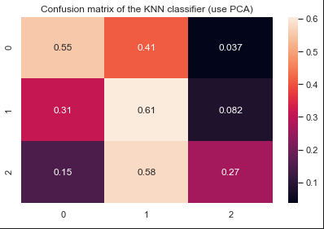
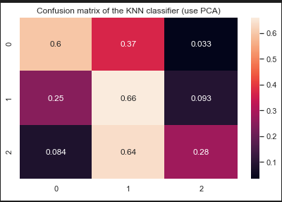
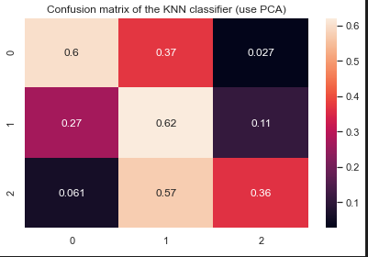
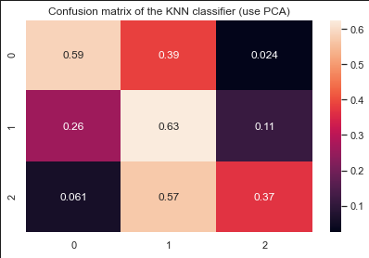
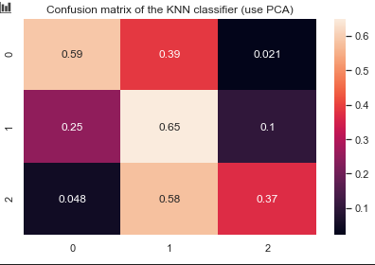
Dimensions vs Confusion Matrix
3 dimensions
4 dimensions
5 dimensions
6 dimensions
7 dimensions
8 dimensions

Slide 16
Choosing the right algorithm for the right dataset
Expectations
Define your metrics of success. Find what is best for you. Usually, this is related to some measure of classification accuracy, but that is not necessarily always the case. You could be interested in model interpretability, computation speed, etc. Even if predictive accuracy is your goal, there are several possible metrics, some more adequate than others, depending on the goals of your task. So, basically decide on the evaluation metrics before.
Affordability
This refers to the costs incurred by running machine learning algorithms on H/W resources that can process high volumes of data in reasonable amounts of time
This also refers to the amount of datasets at your disposal: for smaller datasets do not expect wonders (i.e. high prediction accuracy)
Pragmatism
Based on initial research: the choice should at least depend on the number of samples / features that you have. If you only have a few samples, don't use a complex classifier that will overfit on your data.
You could also try looking at low-dimensional representations of your data to see how the data is distributed, whether there are any clusters, outliers etc and decide accordingly.

